Slide 1

MAHAKAL INSTITUE OF TECHNOLOGY AND MANAGEMENT
Bachelor of Engineering
(Computer Science and Engineering)
2014
Guided By:
Mr. Shashank Sir
Submitted By:
Miss Ritu Tiwari
Palash Bairagi
Sanyam Choudhary
Ankit Bais

Slide 3

CONTENTS
Introduction
Purpose
Abstract
Minimum software and hardware requirements
Snapshot
Data Flow diagram
ER Diagram
Advantages
Disadvantages
Limitations
Conclusion

Slide 4

Introduction
Contact Solution is a web based application
for storing contacts online and sending mails or messages from one PC to another PC.
Contact Solution allows its users to manage his/her contacts online and made him/her able to sent messages and mails between PC to PC in all over the world.
This can be done through Internet and Local Area Network environments.

Slide 5

Purpose
The purpose of the Contact Solution is to provide an online notebook where all types of users can store their contacts online and able to send them messages and mails but we can send mails to anyone which may be or may not be use this website(Contact Solution).

Slide 6

Abstract
This web application provides an user personal account which would be created by giving User Name and Password for it in the Login Page of the Contact Solution.
After user login into the Contact Solution he/she will become able to send mails and messages to another users from PC to PC.
When messages have been sent, then it also keep the record of the sent messages and also the records of the incoming messages and the messages which have been saved in the draft.

Slide 7
(Cont…)
Using this site user can update, Edit, view his/her profile and contacts.

Slide 8

Minimum Hardware & Software Requirements
Processor
RAM 256MB
Hard Disk 80GB

Slide 9

Software Requirement
Eclipse
MySQL
JDK 1.7
Apache-tomcat-6.0.18

Slide 10
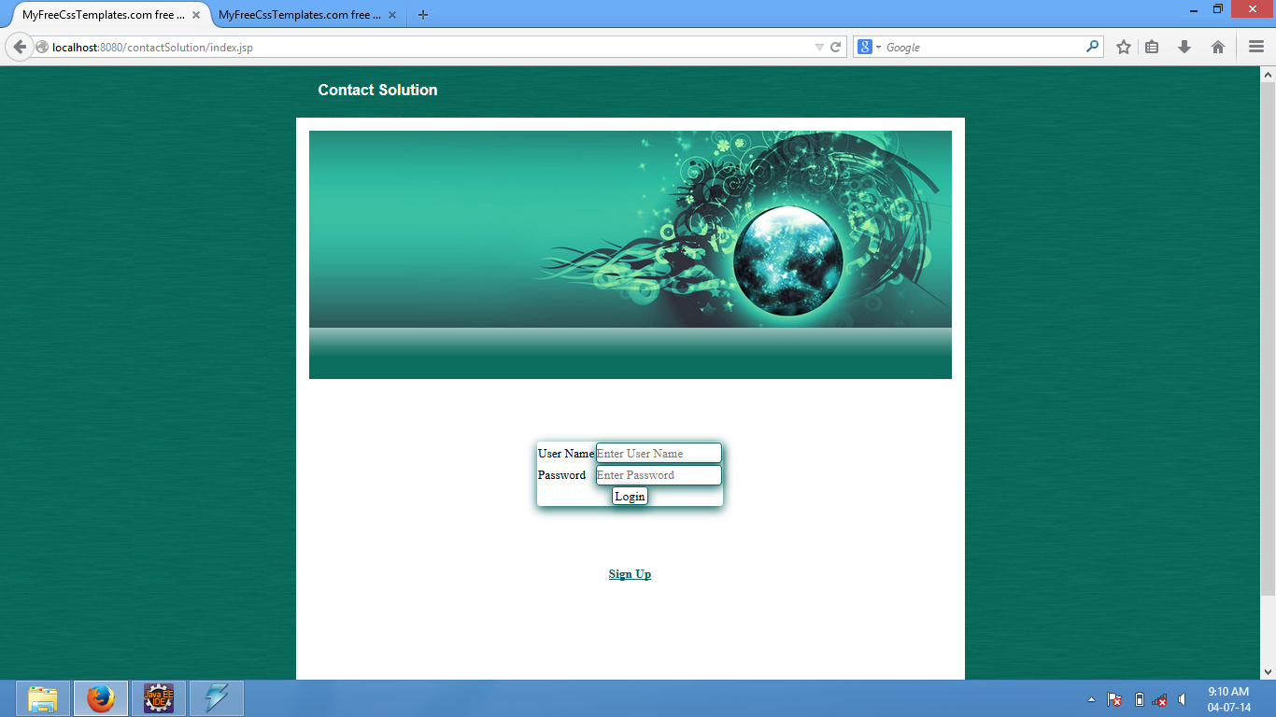

Slide 11
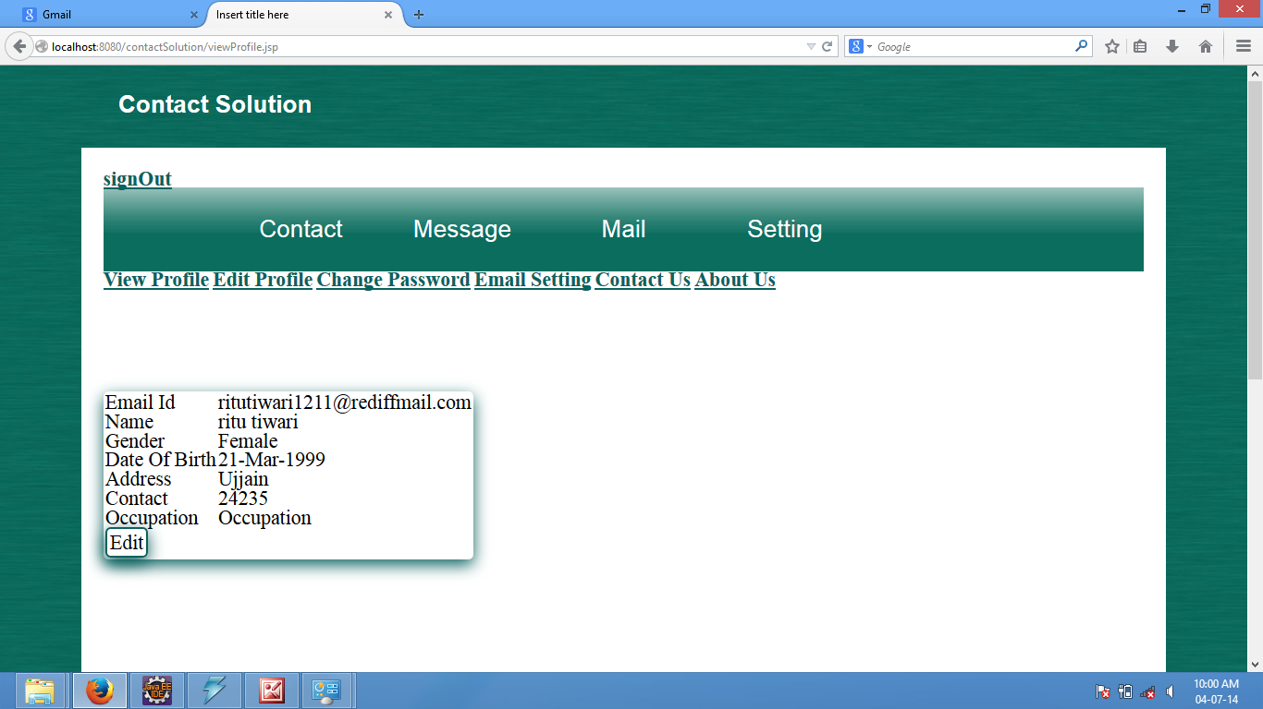

Slide 12
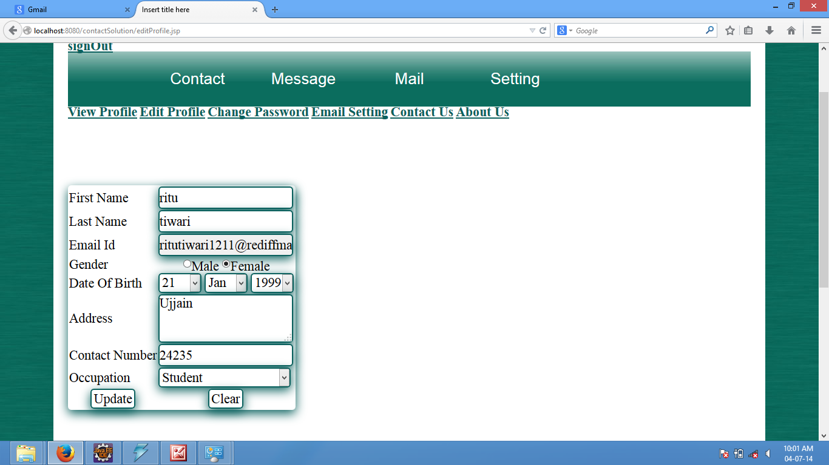

Slide 13
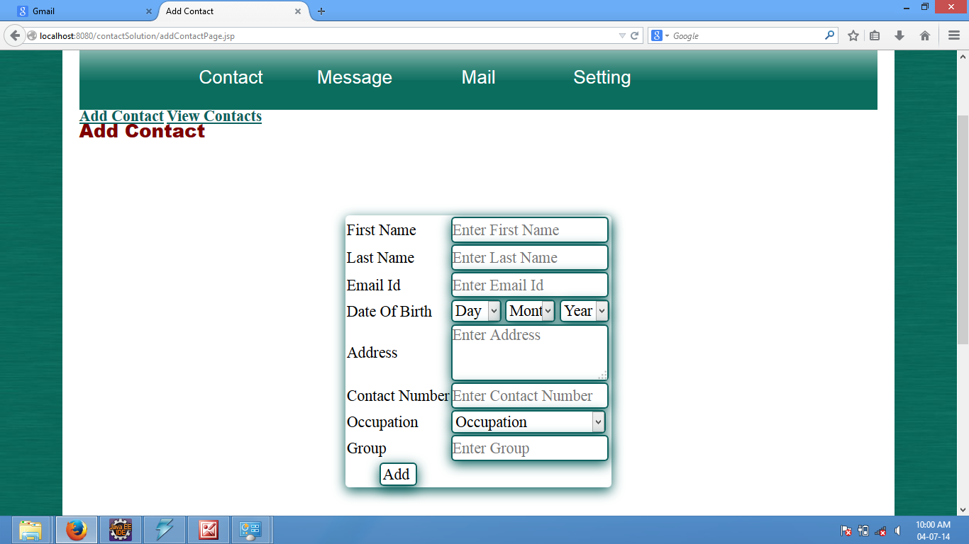

Slide 14
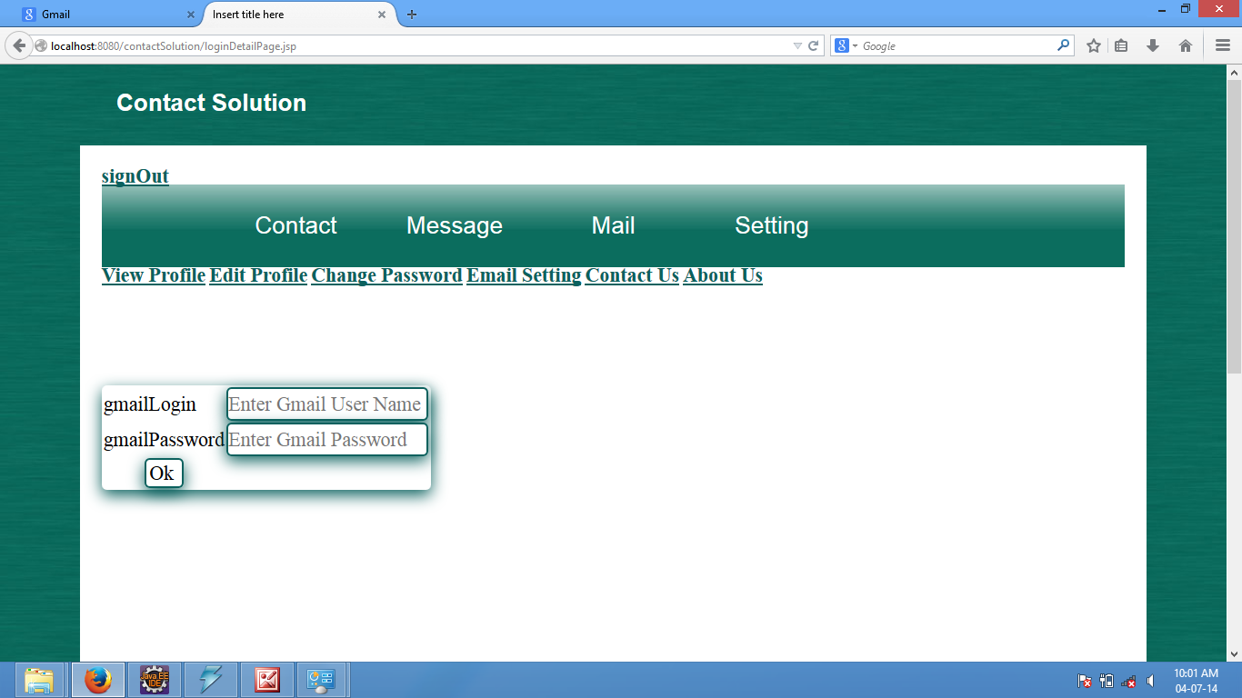

Slide 15
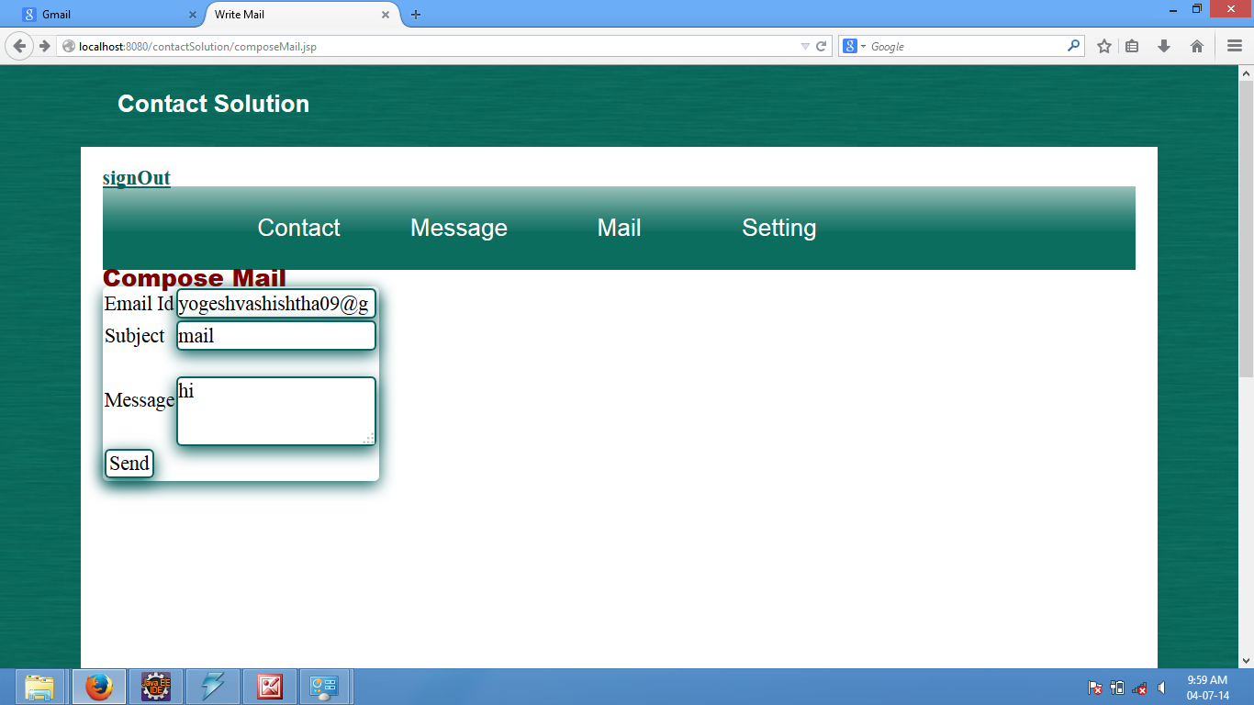

Slide 16
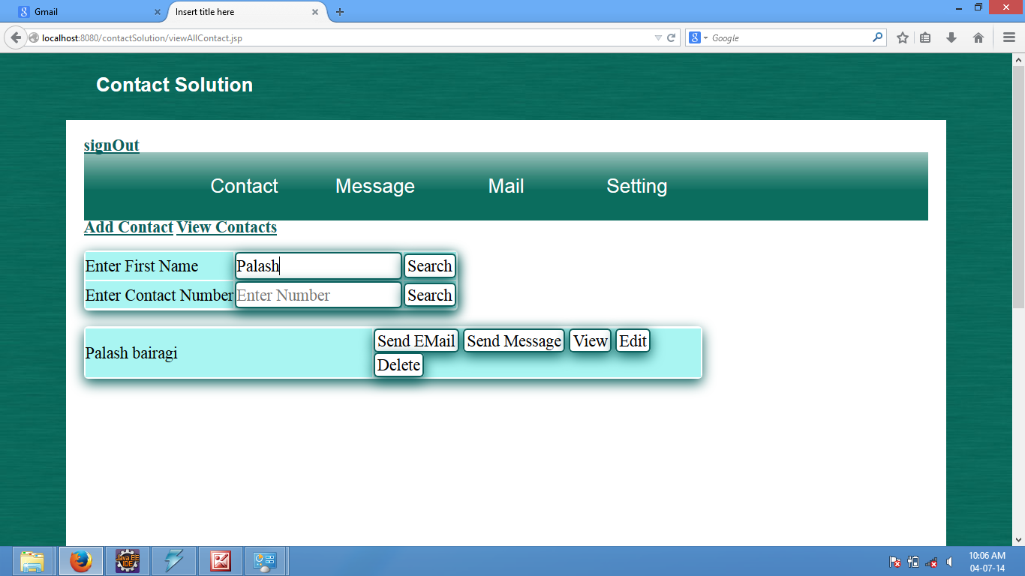

Slide 17
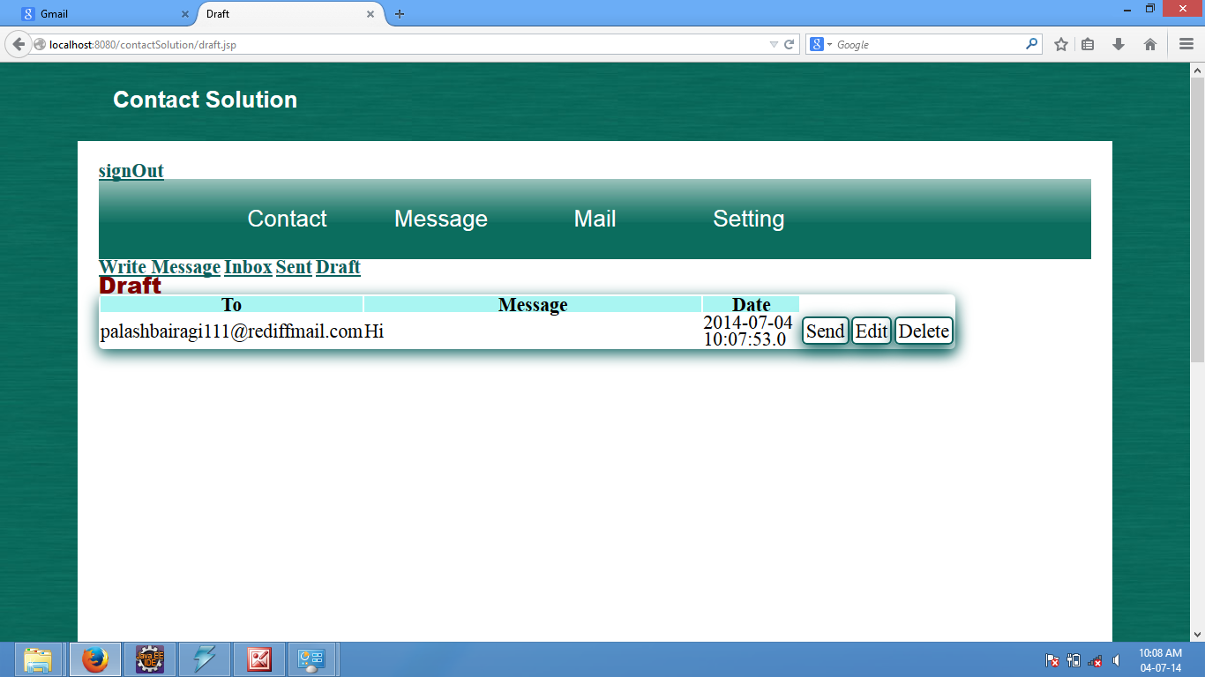

Slide 18
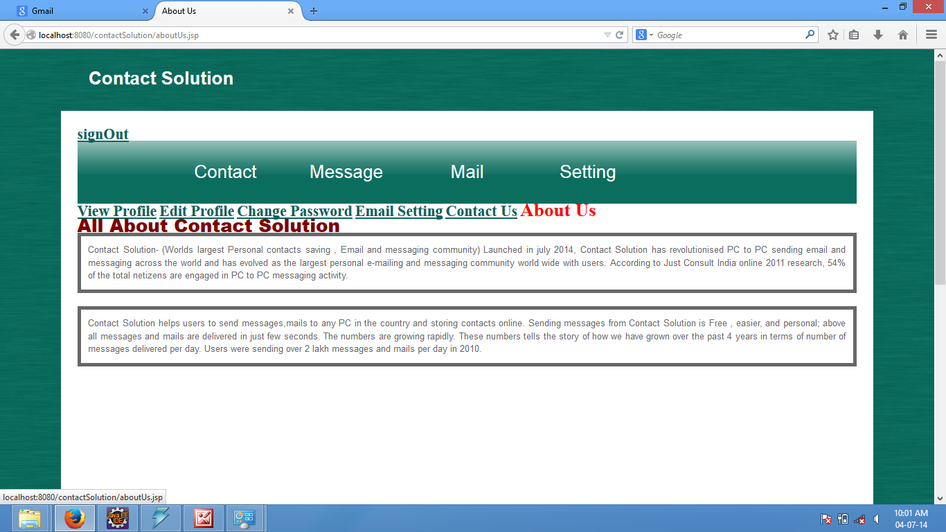

Slide 19
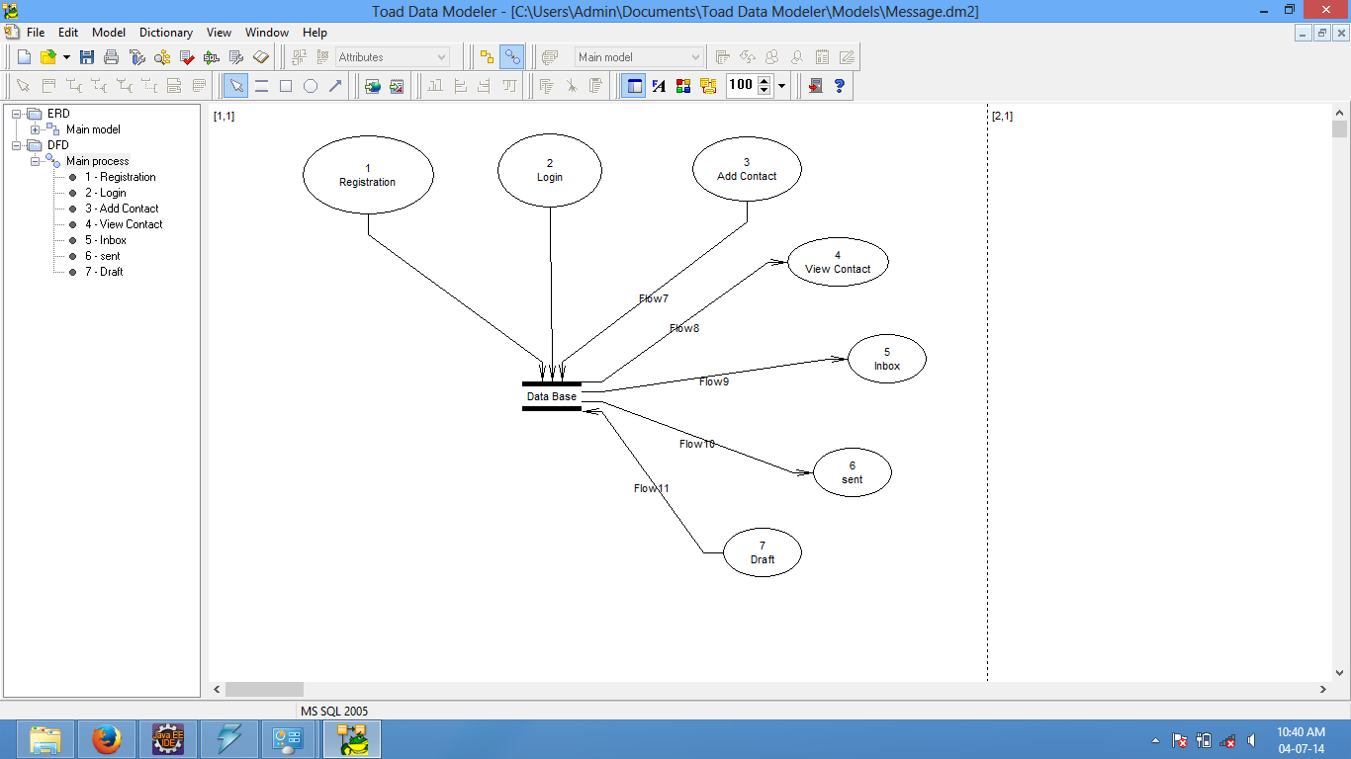
Data Flow Diagram

Slide 20
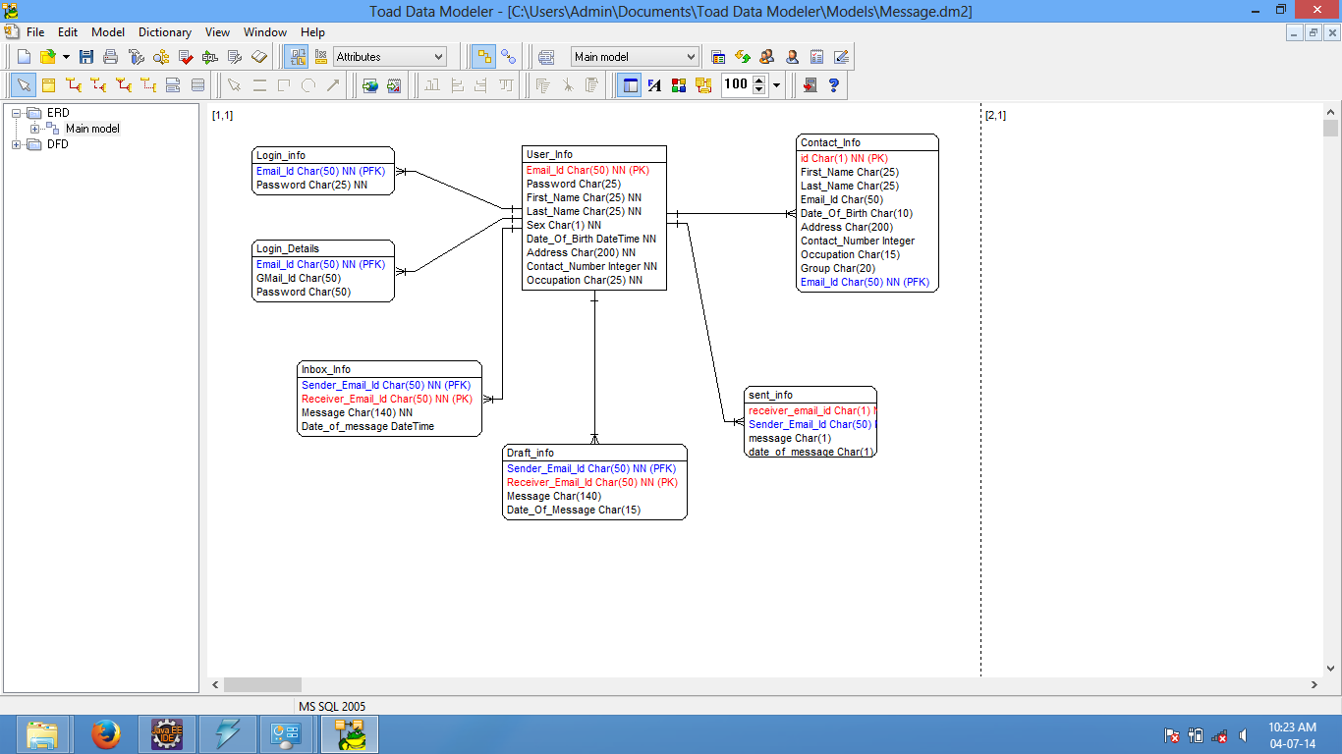
ER Diagram

Slide 21

Advantages
Backup of contacts help in the situation when the Sim or Phone is destroyed or lost.
It can save many contact numbers and had no limitations regarding to it.
Easily accessible.
Less time consuming.
Easily sending of e-mail and messages.
Secured with e-mail Id and password.

Slide 22

Disadvantages
Messages can only be send to the users of Contact Solution and not to other individuals.
Internet must required.

Slide 23

Limitation
It is restricted to e-mail and messaging, voice calling and video calling can not be done from it.

Slide 24

Conclusion
The Contact Solution is very helpful for today’s generation as it is less time consuming and easily accessible and helps in maintaining the records of contacts. Messaging and E-mail can also be easily send through it. Though there are some disadvantages and limitations of it but it is more beneficial and its advantages are more which overrule all the limitations of it.
This website is on the way of progressing. Many improvements will occur in future.

Slide 25
Let’s start
project demo

